Slide 1
Topic 5: When Plans Change
DNA: The Secret Life
Deoxyribonucleic acid , (DNA), is the molecule that is responsible for life.
Chromosomes, (strands of DNA), are located in the nucleus of a cell. DNA controls everything the cells do. DNA is the genetic material that is passed on from parent to offspring.
The Structure of DNA
DNA is shaped like a coiled ladder, (spiral staircase). The sides consist of alternating sugars and phosphates. The rungs

Slide 2
The Genetic Code
Protein molecules make up the structure of the cells and tissues. They also control how a cell is formed and what functions it will perform. DNA that codes a specific protein is called a gene.
Chromosomes
These are tightly coiled strands of DNA. Humans “normally” have 46 chromosomes, (23 from the mother and 23 from the father). If a chromosome is “missing” a defect will result. Each cell must have a complete set of chromosomes.
***Cats have 38 chromosomes (19 from each parent)
*** Horses have 32 chromosomes (16 from each parent)

Slide 3
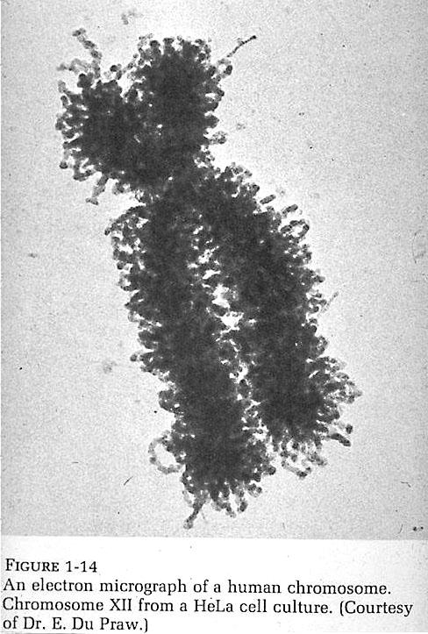
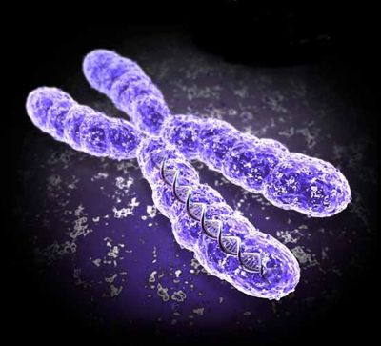

Slide 4
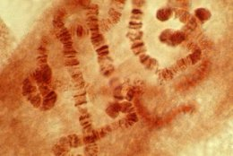
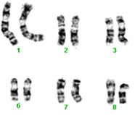
Cat Chromosomes
Horse Chromosomes
http://www.youtube.com/watch?v=8kK2zwjRV0M

Slide 5
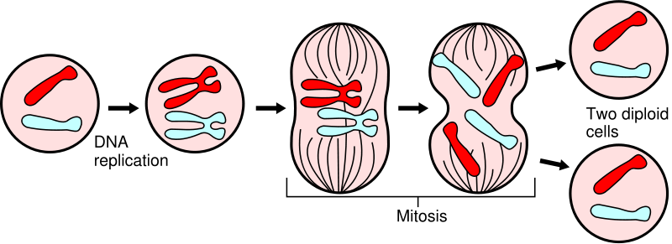
Normal Body Cell, (Somatic) Replacement
Multi-cellular organisms cells divide for growth, repair and replacement of tissues. Prior to dividing a copy of each chromosome is made. The cell then divides by mitosis. This process essentially splits the cell into two new cells that are genetically identical to each other and the original cell.

Slide 6
Life Spans of Different Human Body Cells
Brain 30 – 50 Years
Red blood 120 days
Stomach lining 2 days
Liver 200 days
Intestine lining 3
Skin cells 20

Slide 7
Sex Cells
These cells, (sperm and eggs) contain only 23 chromosomes. Only when the two sex cells join creating a zygote does the new cell have a complete set of 46. Sex cells undergo meiosis. In this process the cell divides twice not once. The gametes will only have half the original chromosomes of the parent cell. This results in 8.4 million different combinations of the chromosomes when a sperm joins with an egg.
There are two sex chromosomes X and Y. Females have two X’s and males have an X and a Y. Each egg cell formed in a female gets a X chromosome where a sperm cell will get either an X or a Y. It is the sperm type that determines the gender of the zygote.

Slide 8
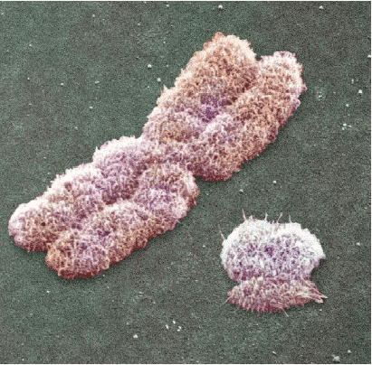
X Chromosome Y Chromosome

