Slide 1
Topic 5 - Getting Away From It All
Exploitation of the environment happens all the time. As the world population grows waste production also grows and the proper handling of this waste is a concern.
(Video)
Environmental Monitoring
All wastes entering the environment are potentially harmful and must be broken down into non-polluting compounds, or be treated to reduce the harmful effects these wastes can have.
Non-persistent wastes care naturally degraded. Persistent pollutants accumulate and take a long time to degrade.
It is the concentration of these wastes that can affect living organisms.

Slide 2
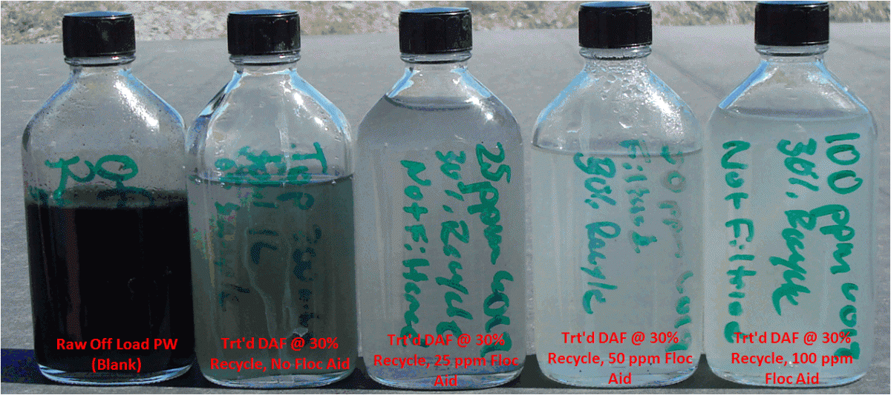
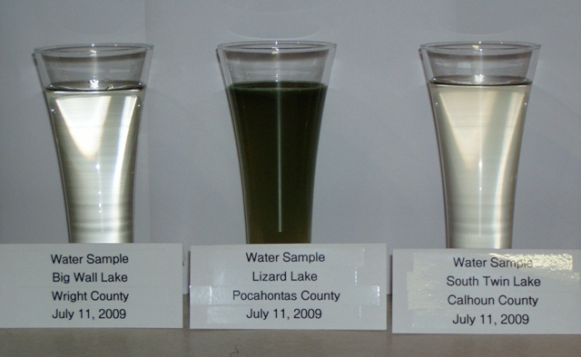
Monitoring:
Clarity may be one indicator, but clear water does not indicate what chemicals are present.
Water Quality is determined using chemical and biological indicators according to what the water is going to be used for.

Slide 3
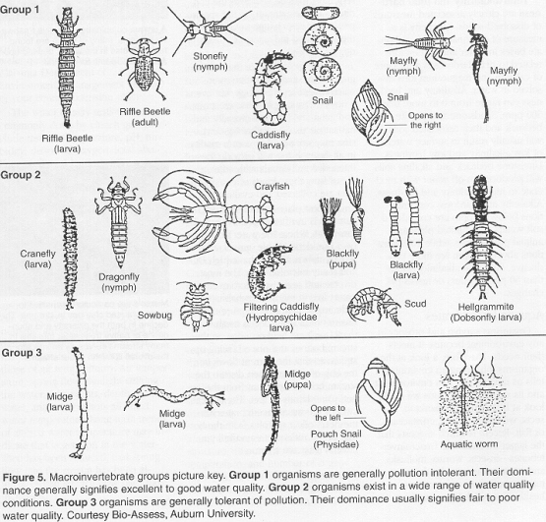
Biological Indicators of Water Quality
Most types of pollution adversely affect water quality and directly affect living organisms. Microscopic organisms (bacteria) can cause serious health problems if they are present in sufficient numbers. Samples are taken to identify their presence to avoid contamination of the water supply.
Aquatic Invertebrate Identification:
Be familiar with Page 231/233

Slide 4
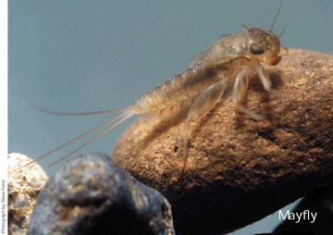
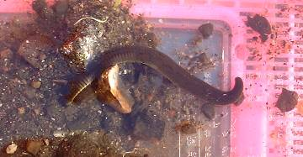
Aquatic Environments are places where macroinvertebrates – visible to the human eye, without a backbone - live depending on the pH level and the amount of dissolved oxygen present.
There will likely be no fish, shrimp, mayfly or stonefly invertebrates in water that has a pH below 5.0
Worms, leeches and midge larva thrive in polluted water, as they require only small amounts of dissolved oxygen for survival

Slide 5
Chemical indicators of water quality include: dissolved oxygen, acidity, heavy metals, nitrogen, phosphorus, pesticides, salts – such as sodium chloride and magnesium sulfate.
***Know these indicators***
Point Versus Non-point Sources
Pollutants entering the environment from specific locations are point source pollutants. These are easy to monitor and control.
Non-point source pollutants are those that enter the environment from locations that cannot be easily monitored or controlled. They occur as a result of run-off or leaching and they get dispersed quickly.
Agencies set regulations and monitoring protocols to determine amounts affecting the environment.
The 4Rs – Reduce, Reuse, Recycle and Recover - have provided a basic framework to reduce the amount of waste pollutants that are produced.

