Slide 1
Topic 5: Portable Power
Electrochemical Cells
Two metal electrodes are surrounded by an electrolyte. These cells supply a steady current. The chemical reaction in a cell releases free electrons, which travel from the negative terminal of the cell, through the device, which uses the electricity, and back to the positive terminal of the cell. The chemical reactions within the cell determine the potential difference (voltage) that the cell can create. Several cells connected in series produces a higher voltage, and is commonly referred to as a battery, which is a sealed case with only two terminals.
A primary cell is one in which the reactions will not continue after the reactants are used up.

Slide 2
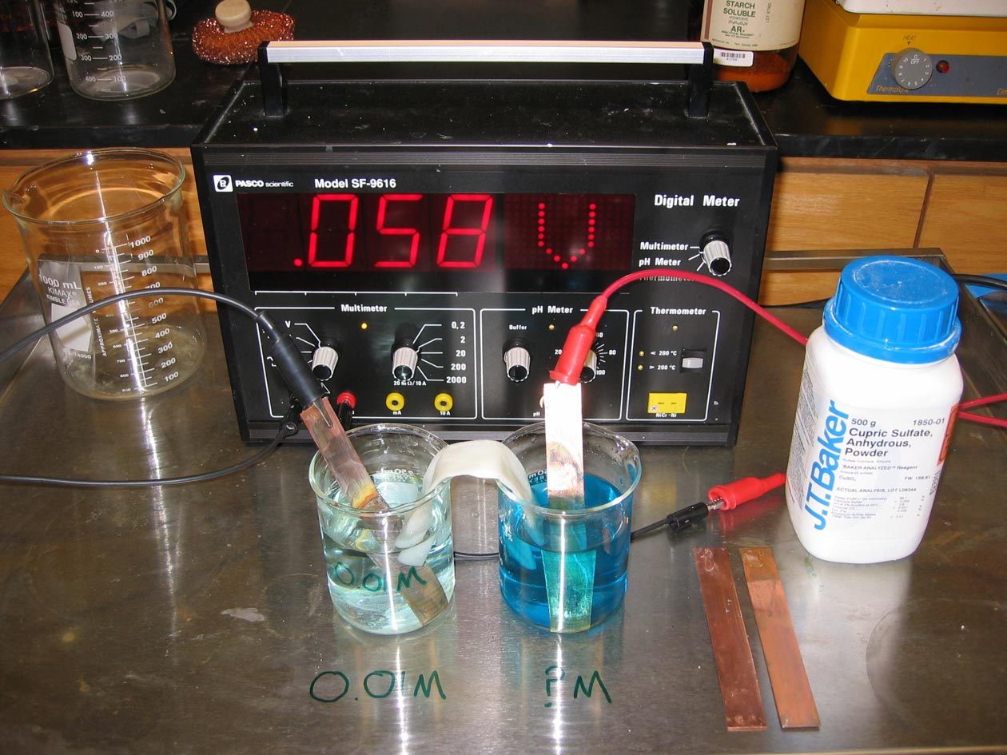
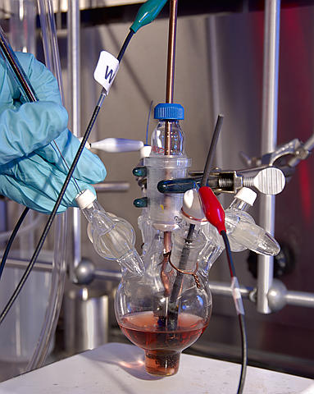
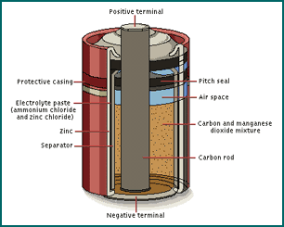

Slide 3
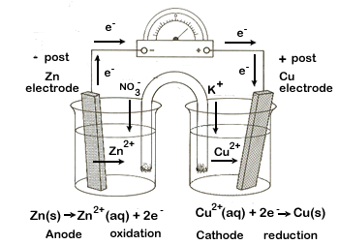
Wet cells use a liquid electrolyte. Wet cells are 'wet', because the electrolyte is a liquid (usually an acid). Each electrode reacts differently in the electrolyte. The acidic electrolyte eats away one electrode, leaving behind electrons that give it a negative charge. The other electrode is positive, but it is not eaten away. Electrons travel from the negative terminal through the device and on to the positive terminal
http://www.youtube.com/watch?v=0oSqPDD2rMA

Slide 4
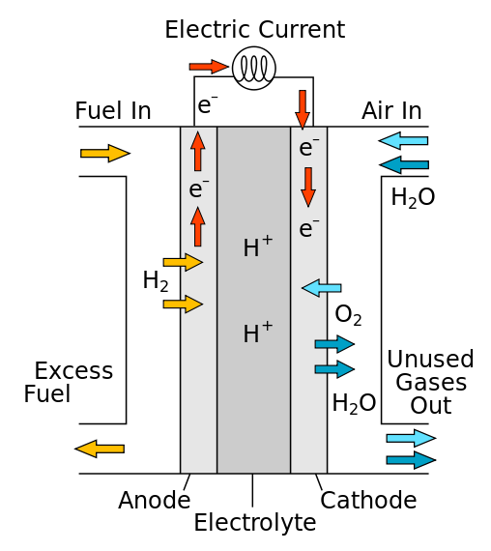
Hydrogen Fuel Cells
https://www.youtube.com/watch?v=LSxPkyZOU7E
https://www.youtube.com/watch?v=YJBzEYduKK8

