Slide 1
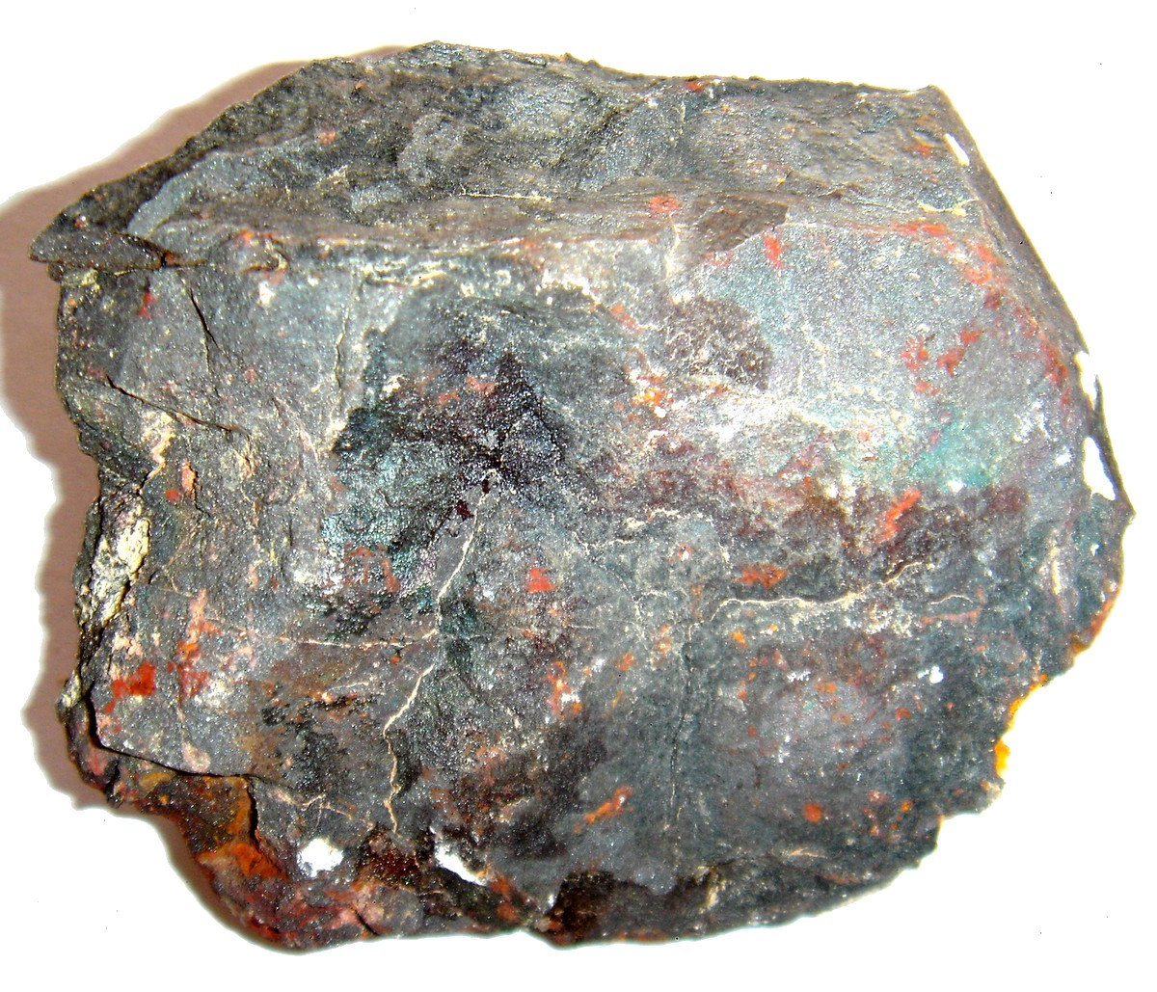
Separating Earth's Mixtures The Earth is rich in natural mixtures
Separating Mixtures - when fluids are used to make solids flow, the solids must later be recovered - separation methods are designed to take advantage of the unique properties of the substances that have been mixed

Slide 2
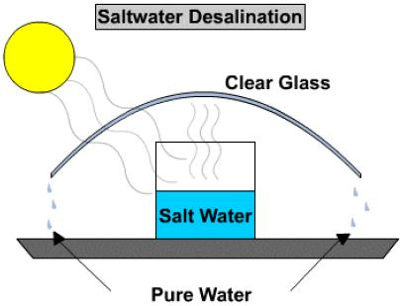
Desalinating Water - the 'desert tent method' (much like distillation) is inexpensive, but slow, and only practical in areas which receive a lot of bright sunlight
You should sketch a similar
diagram into your notes.
- desalination plants, along the Red Sea, use lots of energy and are very expensive to operate
- the process of removing water from a solution is called dehydration - the solvent (which is the water, in most cases) is separated from the solution by means of evaporation
http://www.youtube.com/watch?v=aysj7696b0A

Slide 3
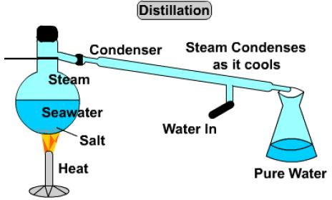
Distillation is a separation method that allows all the liquid fractions of a mixture to be separated from each other and collected independently.
You should sketch a similar
diagram into your notes.
all seawater contains salt, but in varying amounts - from place to place, with the dead sea having the highest concentration
http://www.youtube.com/watch?v=xxNfJLMNS4E

Slide 4
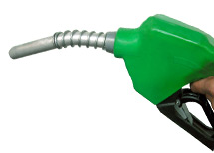
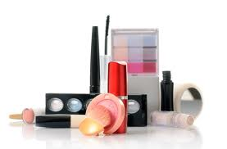
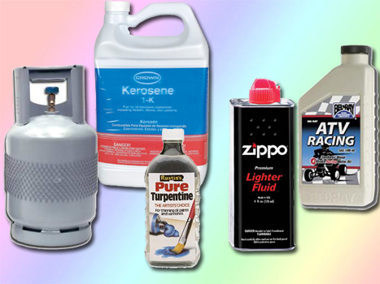
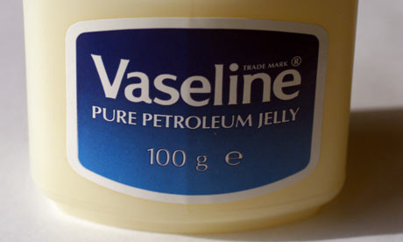
Processing Petroleum - petroleum is a natural mixture of hydrocarbons and must be processed to recover useful petroleum products - the process that does this is called fractional distillation - when the petroleum is heated, it changes into a gas (vaporize), which is collected and cooled, enabling it to change back into a liquid (recondense) - the recondensed liquid is further separated (the parts redondense at different temperatures) into each of the fractional parts, that are soluble in each other, but not in water - fractional distillation is done in a two-tower structure and the fractional products can then be converted (further processed) into over 500,000 types of petrochemicals

Slide 5
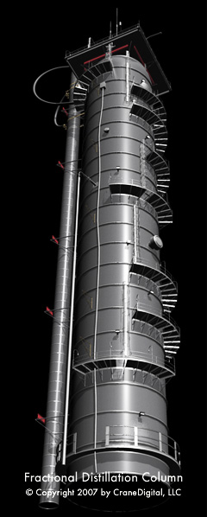
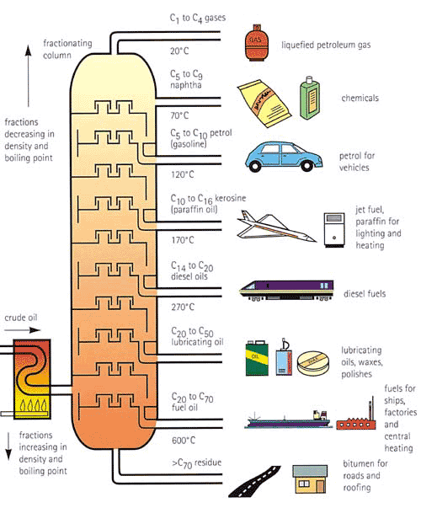
http://www.youtube.com/watch?v=26AN1LfbUPc

Slide 6
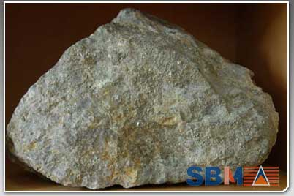
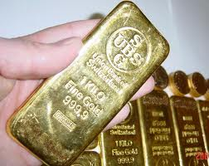
Solid Mixtures From Underground - an ore is a mineral (or group of minerals) that contains a valuable substance (like gold) - to extract the substance (gold) that needs to be recovered it must be mined and crushed, then mixed with water to create a fine suspension - chemicals are then added to dissolve only the substance (gold) you want - the substance (gold) is then released from the solution when another substance (zinc) is added, allowing the residue (gold) to sink and be collected
Applications - Convenience foods are often dehydrated, so they can be stored for long periods of time without spoiling (you just add water when you want to use it) - petrochemical products include aspirin, sports equipment, eyeglasses, chewing gum, duct tape and fertilizer - there are many different types of salt, the most common one is sodium chloride (table salt) , potassium chloride is potash - sugar beets and sugar cane are refined to give us sugar crystals, maple sap is boiled to make 'sweetwater' or maple syrup
http://www.youtube.com/watch?v=nCDCQtcPeGU

