Slide 1
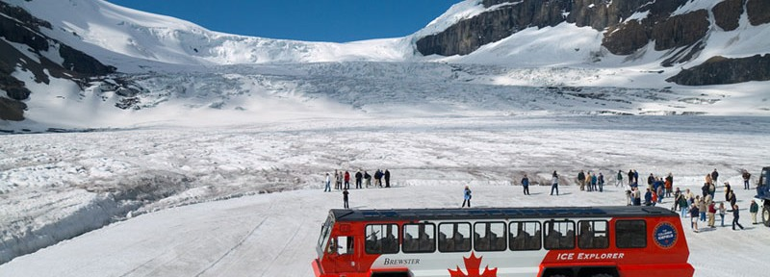
Topic 2 – Earth’s Frozen Water
What is a Glacier?
Large bodies of moving mass of ice and snow are called glaciers. An ‘ Ice Cap ’ is a glacier that forms on an extensive area of relatively level land that flows out from its source. An ’ icefield ‘ is an upland area of ice that feeds two or more glaciers. (The Columbia Icefield, in the Rocky Mountains, feeds 6 glaciers, is the source of three of Canada’s major rivers and replenishes three different oceans.)
How Do Glaciers Form?
All glaciers begin as snowflakes. These snowflakes accumulate, becoming grains, ice crystals and the weight of the snow creates pressure that gradually changes the ice crystals into glacial ice.

Slide 2
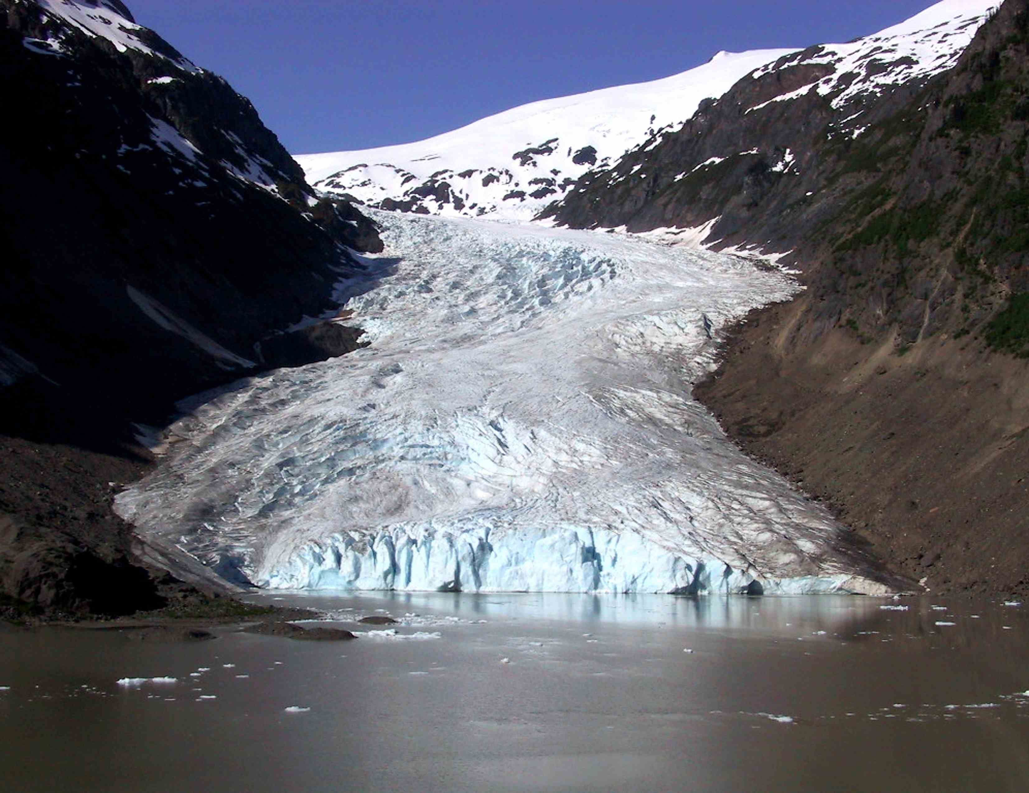
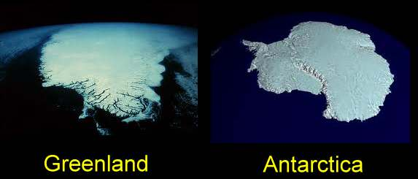
Valley Glaciers
Glaciers form high in the mountains and move through valleys between mountain peaks. These are called valley glaciers.
Continental Glaciers
Those covering large areas of land are called continental glaciers or icecaps. Continental glaciers cover Antarctica and Greenland.

Slide 3
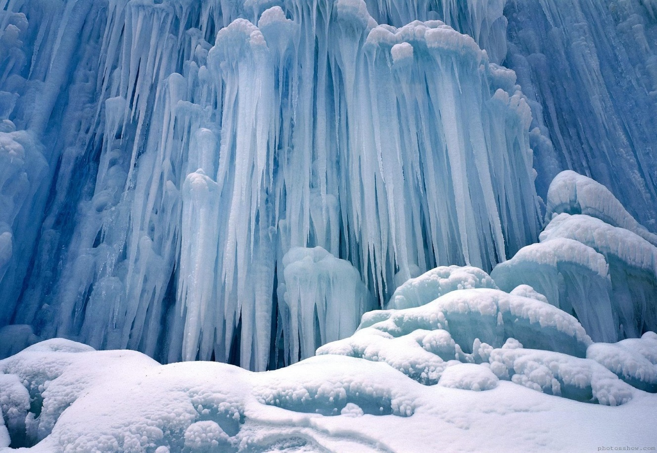
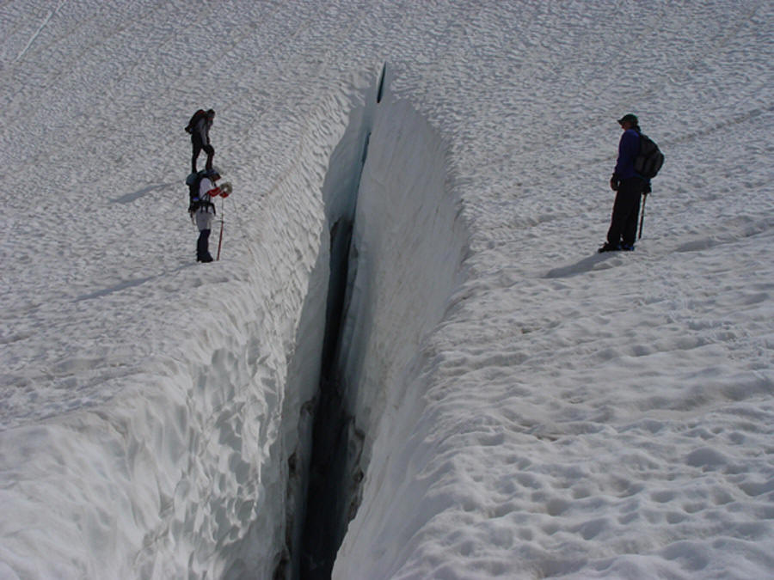
Glacial Features
The shapes that develop in flowing ice are unique. Where a glacier flows over a steep cliff and breaks up, an icefall results. A crevasse is a fissure, or crack, in the ice.
Glacial Movement
The movement of glaciers depends on the climate. In colder climates, little melting occurs and the glacier continues to grow or move forward (this is called an advancing glacier). If the climate is warmer, the glacier melts faster than it grows and leaves the rocks, soil and large boulders it once contained. These glaciers are called retreating glaciers.

Slide 4
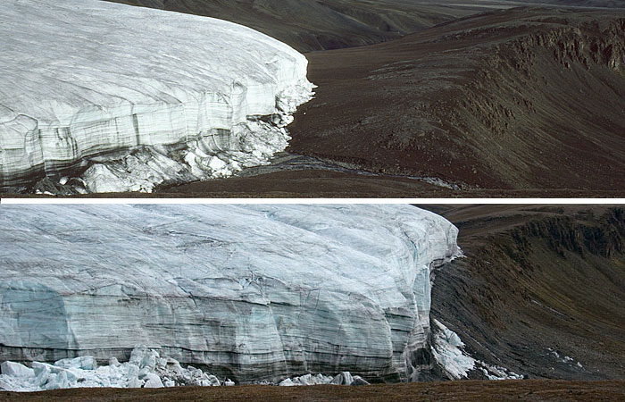
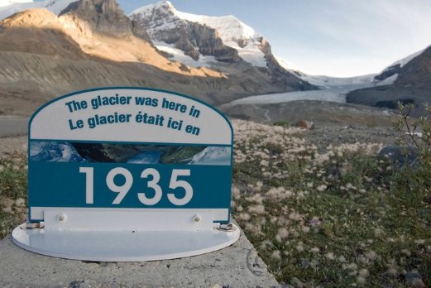

Slide 5
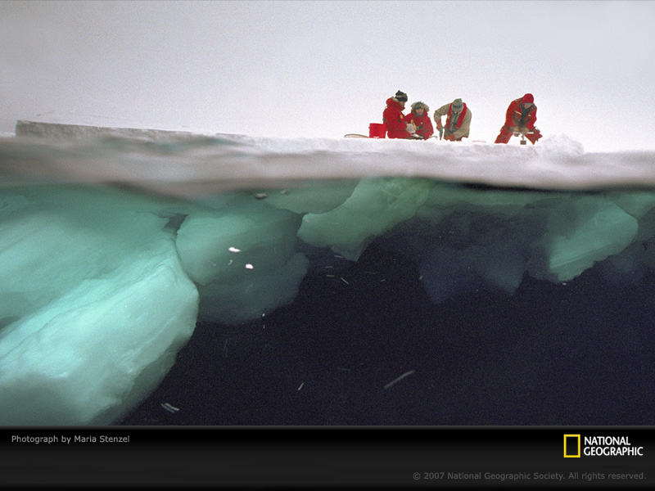
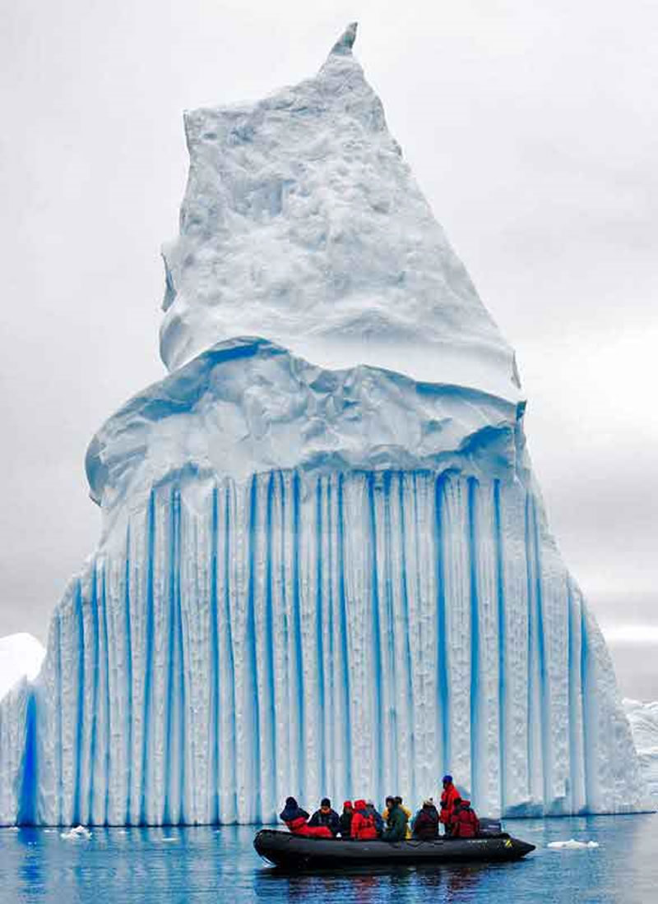
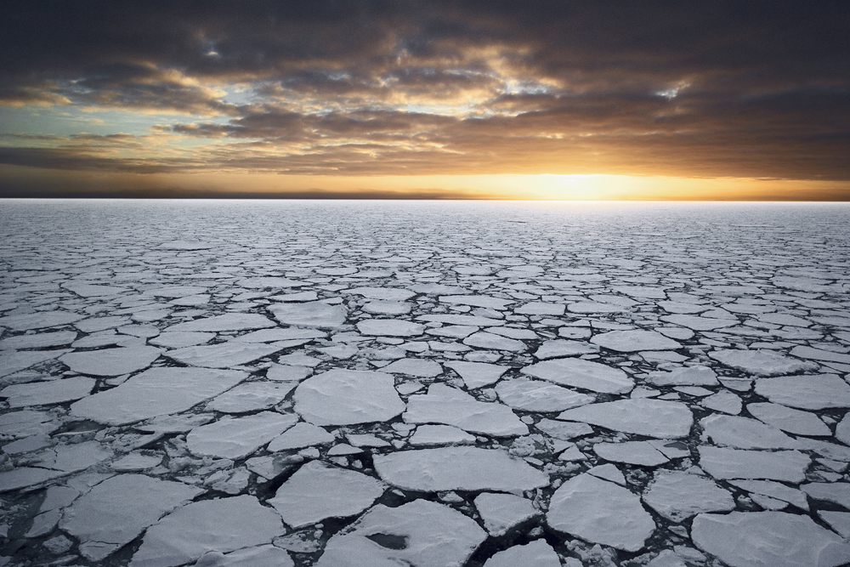
Pack Ice and Icebergs
Pack ice is a sheet of ice that is rarely more than 5 meters thick that breaks easily. This usually happens in freezing sea water when large pieces break off as they move into warmer water. Icebergs are large chunks of ice that break loose, or calve, from continental glaciers as the glaciers flow into the ocean. These chunks are visible as they move through the ocean, melting faster below the surface than above.

Slide 6
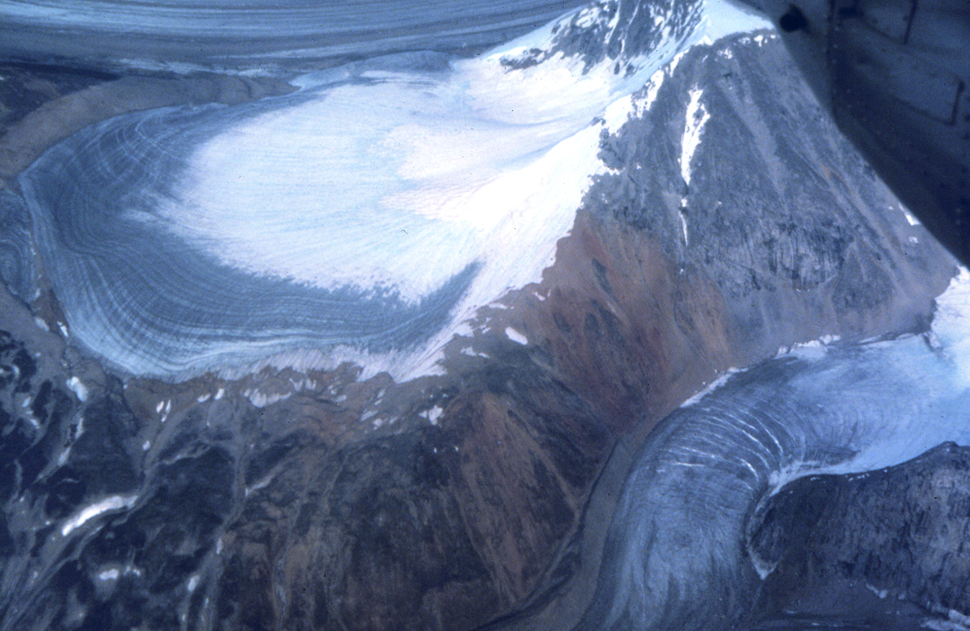
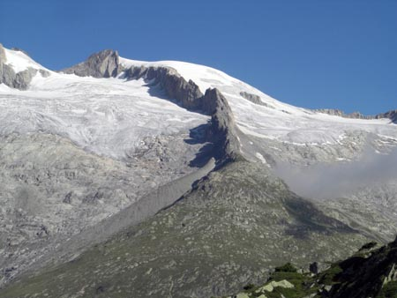
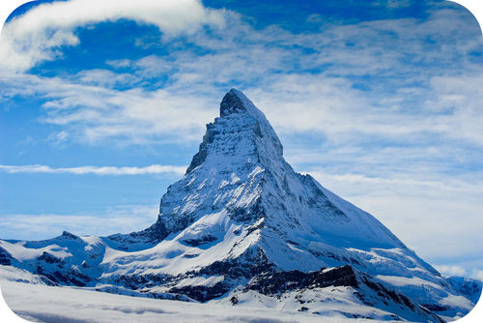
How Glaciers Shape The Land
Glacial Erosion
As glaciers advance or retreat, they create specific glacial features across the landscape.
Evidence of Valley Glaciers Valley glaciers carve (erode) bowl-shaped basins, called cirques in the sides of mountains. When two or more glaciers act on a mountain – eroding it from two different directions, a ridge forms, called an arête. If it forms a sharpened peak it is called a horn.

Slide 7
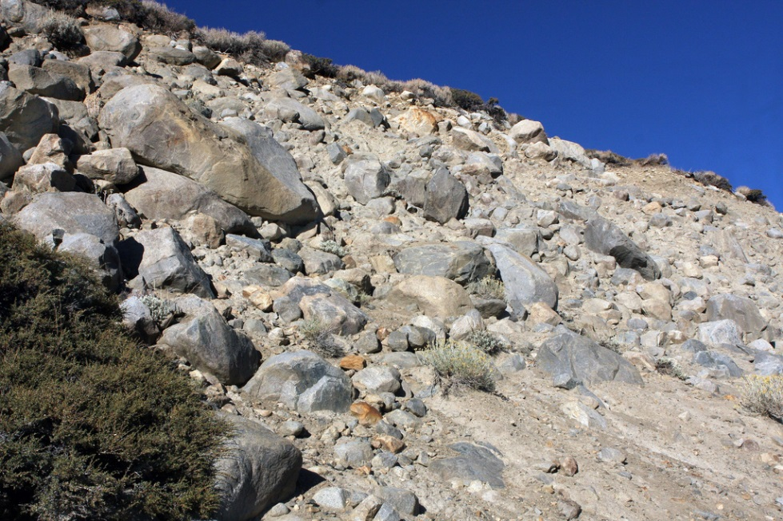
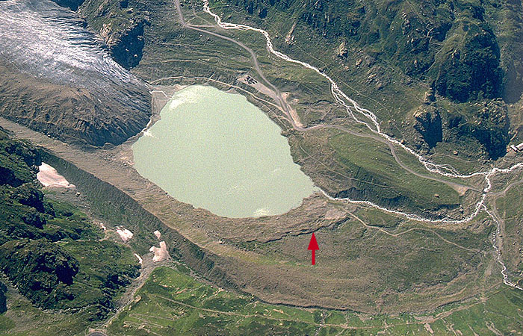
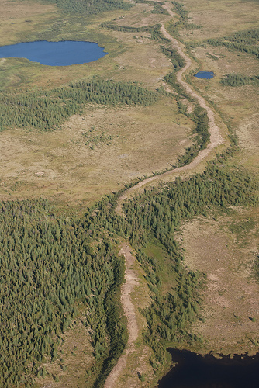
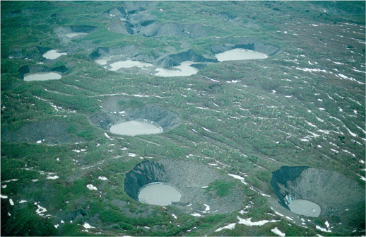
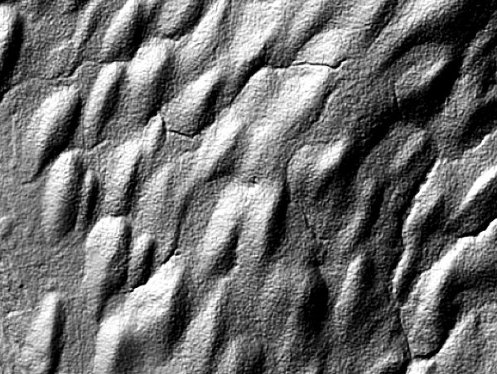
Glacial Deposition
The collection of rocks, boulders, sand, clay and silt that is left behind as a glacier slows down and melts, is called till.
Till
Esker
Moraine
Drumlin
Kettle Lakes

Slide 8
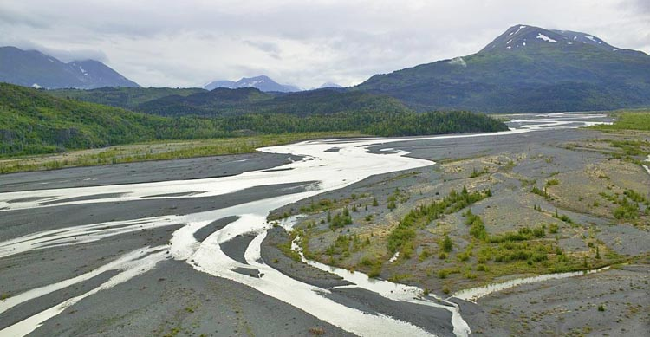
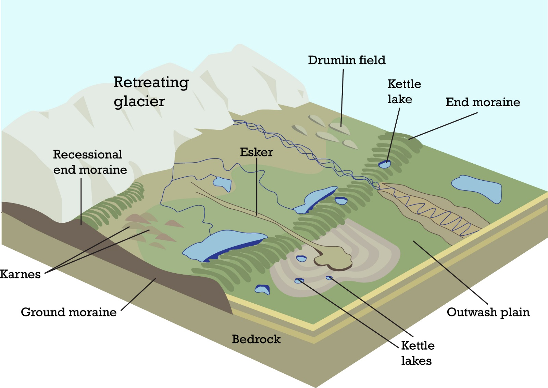
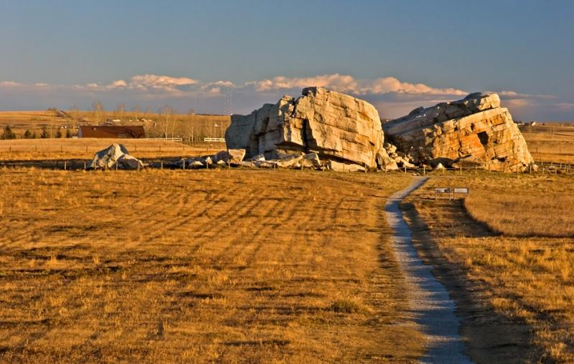
Outwash Plain
Outwash Plain
Erratic
“Big Rock” Okotoks

Slide 9
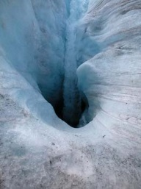
Meltwater Features
Meltwater - water formed by the melting of snow and ice – carves channels in and throughout glaciers. A millwell is a rounded drain in the ice that is chiselled by a stream as it plunges downward.
The Importance of Glaciers
Icefields, glaciers, and snow – high up in the mountains – act as natural reservoirs, collecting snow in the cold months and releasing it as meltwater as it warms up. This meltwater helps run hydroelectric plants, irrigate crops, water cattle and supply drinking water. Glaciers slow the water cycle and provide important clues to understand historical climate patterns.

Slide 10
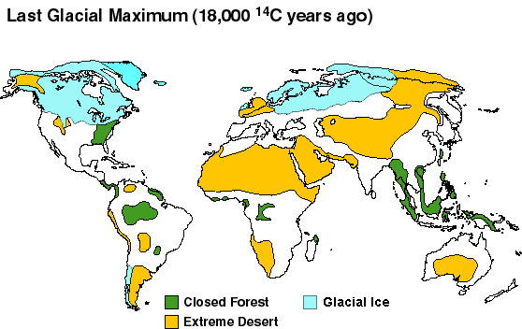
Ice Ages
The Earth has had 7 major Ice Ages over the last several million years. During this time glaciers covered approx. 28% of the Earth’s surface. In the last Ice Age, Canada was completely covered by a continental glacier. At the peak of the Ice Age the average temperatures around the world were 5ºC colder than they are now.
Ice Ages and Climate Change
A small change in the average temperature is enough to start a chain of events that can produce an Ice Age.
• There might be reduced thermal energy from the Sun.
• There might be increased volcanic activity – adding clouds of ash into the atmosphere, thus reducing how much thermal energy from the Sun reaching Earth.
• Mountain building may cause more snow to accumulate and reflect sunlight – thus reducing the temperature.
• The movement of Earth’s tectonic plates alters the shape of the oceans and affects ocean currents, causing less mixing of hot and cold water.
• A change in the tilt of the Earth’s axis may also alter the temperature.

Slide 11
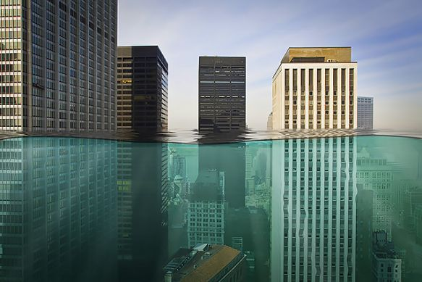
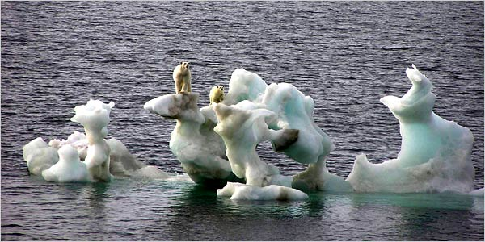
Climate Changes Today
The greenhouse effect and global warming are two unrelated events that affect the average temperature on the Earth.
The greenhouse effect is the natural warming of the Earth caused by gases in the Earth’s atmosphere trapping heat. Without it, life would not be able to survive. Global warming is the increase of these greenhouse gases, which causes more heat to be trapped and the temperature around the world increases – causing ice caps to melt producing widespread flooding.

