Slide 1
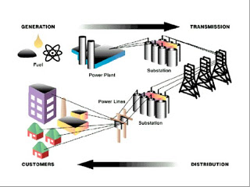
Topic 7 - Electricity in the Home
Transmission of Electricity Power Grid Transformers are used to change the amount of voltage with hardly any energy loss. Voltage change is necessary because the most efficient way to transmit current over long distances is at high voltage and then reduced when it reaches its destination, where it will be used.
Step-up transformer increases voltage at the generating plant
Step-down transformer reduces voltage just before entering your home.

Slide 2
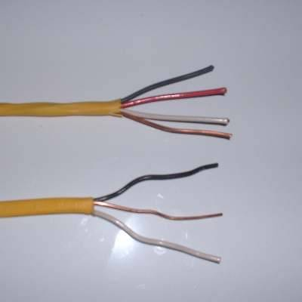
From the Grid into Your Home
Coming in contact with a power transmission line can prove to be deadly. Power needs to enter your home safely. Electrical power enters a meter on the side of your house where electrical usage is recorded on little dials.
Power is then routed into the service panel (usually in the basement).
The main circuit breaker shuts off all the power in the house at once, in case of an overload.
The individual circuit breakers in the service panel control the branch circuits, located throughout the entire house.
Each branch circuit is a series of 14 gauge electrical cables that contain:
2 ‘live’ insulated wires (white – neutral; and black – hot);
And, a ‘ground’ wire (bare copper wire, or insulated green).

Slide 3
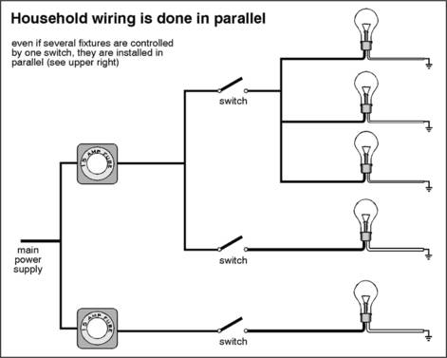
Home Wiring
To install or change electrical wiring in your home a permit is necessary and all work done must meet a set of standards called the electrical code.
Digital Devices
The four basic elements of a circuit are present in a microcircuit, as well as a normal electrical circuit. Conductors are thin traces of copper, instead of wires. Resistors and lamps are similar, but the switches are very different.
To process the digital information switches in microcircuits use ‘binary code’ – 0 and 1 - for on and off.

Slide 4
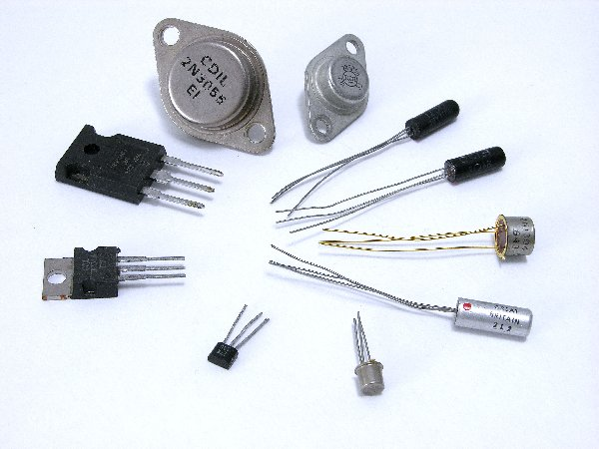
These electronic digital switches are transistors – solid state components that are controlled by electronic signals. The transistors can then control other signals.
Electrical Safety
Summarize the points on Page 330 (Home Safety), and Page 331 (Outdoor Safety)
http://www.youtube.com/watch?v=BVAWo5l6uwU
http://www.youtube.com/watch?v=vqgNrj6oEdc

